Slide 1
FUZZY LOGIC

Slide 2
Traditional (crisp) logic
In 300 B.C. Aristotle formulated the law of the excluded middle, which is now the principle foundation of mathematics.
X must be in a set of A or in a set of not A.

Slide 3



Traditional (crisp) logic
A rose is either RED or not RED.

Slide 4

Traditional (crisp) logic
What about this rose?

Slide 5

What color is this leopard?

Slide 6

Is this glass full or empty?

Slide 7

A tall guy
Where do tall people start?

Slide 8
What is fuzzy logic?
Fuzzy logic is a superset of conventional (Boolean) logic that has been extended to handle the concept of partial truth -- truth values between "completely true" and "completely false".
* http://www.cs.tamu.edu/research/CFL/fuzzy.html

Slide 9
What is fuzzy logic?
A type of logic that recognizes more than simple true and false values. With fuzzy logic, propositions can be represented with degrees of truthfulness and falsehood. For example, the statement, today is sunny, might be 100% true if there are no clouds, 80% true if there are a few clouds, 50% true if it's hazy and 0% true if it rains all day.
Fuzzy logic has proved to be particularly useful in expert system and other artificial intelligence applications. It is also used in some spell checkers to suggest a list of probable words to replace a misspelled one.
*http://webopedia.internet.com/TERM/f/fuzzy_logic.html

Slide 10
Fuzzy Logic
“ A form of knowledge representation suitable for notions that cannot be defined precisely, but which depend upon their context. It enables computerized devices to reason more like humans”
* http://www.fuzzylogic.co.uk/

Slide 11
Classical Set (Crisp)
Contain objects that satisfy precise properties of membership.
  Example: Set of heights from 5 to 7 feet
1 x A
χ (x) = {
A
0 x A
Characteristic Function
1
0
5
6
7
X (height)

Slide 12
Fuzzy Set
Contain objects that satisfy imprecise properties of membership
  Example : The set of heights in the region around 6 feet
μ (x) Ε {0-1}
Membership Function
1
A
0
5
6
7
X (height)

Slide 13
Fuzzy Logic: Motivations
Alleviate difficulties in developing and analyzing complex systems encountered by conventional mathematical tools.
Observing that human reasoning can utilize concepts and knowledge that do not have well-defined, sharp boundaries.
*Fuzzy Logic: Intelligence, Control, and Information - J. Yen and R. Langari, Prentice Hall 1999

Slide 14
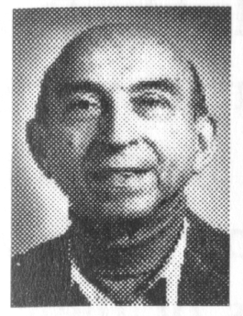
History of Fuzzy Logic
1964: Lotfi A. Zadeh, UC Berkeley, introduced the paper on fuzzy sets.
  Idea of grade of membership was born
  Sharp criticism from academic community
    Name!
    Theory’s emphasis on imprecision
  Waste of government funds!
*Fuzzy Logic: Intelligence, Control, and Information - J. Yen and R. Langari, Prentice Hall 1999

Slide 15
History of Fuzzy Logic
1965-1975: Zadeh continued to broaden the foundation of fuzzy set theory
  Fuzzy multistage decision-making
  Fuzzy similarity relations
  Fuzzy restrictions
  Linguistic hedges
1970s: research groups were form in JAPAN
*Fuzzy Logic: Intelligence, Control, and Information - J. Yen and R. Langari, Prentice Hall 1999

Slide 16
History of Fuzzy Logic
1974: Mamdani, United Kingdom, developed the first fuzzy logic controller
1977: Dubois applied fuzzy sets in a comphrensive study of traffic conditions
1976-1987: Industrial application of fuzzy logic in Japan and Europe
1987-Present: Fuzzy Boom
*Fuzzy Logic: Intelligence, Control, and Information - J. Yen and R. Langari, Prentice Hall 1999

Slide 17
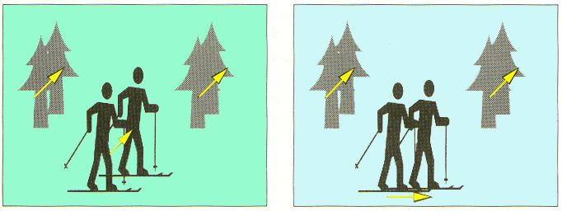
Fuzzy Logic Applications
Image Stabilization via Fuzzy Logic
“If all motion vectors are almost parallel and their time differential is small, then
the hand jittering is detected and the direction of the hand movement
is in the direction of the moving vectors”.
*Fuzzy Logic: Intelligence, Control, and Information - J. Yen and R. Langari, Prentice Hall 1999

Slide 18
Fuzzy Logic Applications
Aerospace
  Altitude control of spacecraft, satellite altitude control, flow and mixture regulation in aircraft deiceing vehicles.
Automotive
  Trainable fuzzy systems for idle speed control, shift scheduling method for automatic transmission, intelligent highway systems, traffic control, improving efficiency of automatic transmissions

Slide 19
Fuzzy Logic Applications (Cont.)
Business
  Decision-making support systems, personnel evaluation in a large company
Chemical Industry
  Control of pH, drying, chemical distillation processes, polymer extrusion production, a coke oven gas cooling plant

Slide 20
Fuzzy Logic Applications (Cont.)
Defense
  Underwater target recognition, automatic target recognition of thermal infrared images, naval decision support aids, control of a hypervelocity interceptor, fuzzy set modeling of NATO decision making.
Electronics
  Control of automatic exposure in video cameras, humidity in a clean room, air conditioning systems, washing machine timing, microwave ovens, vacuum cleaners.

Slide 21
Fuzzy Logic Applications (Cont.)
Financial
  Banknote transfer control, fund management, stock market predictions.
Industrial
  Cement kiln controls (dating back to 1982), heat exchanger control, activated sludge wastewater treatment process control, water purification plant control, quantitative pattern analysis for industrial quality assurance, control of constraint satisfaction problems in structural design, control of water purification plants

Slide 22
Fuzzy Logic Applications (Cont.)
Manufacturing
  Optimization of cheese production.
Marine
  Autopilot for ships, optimal route selection, control of autonomous underwater vehicles, ship steering.
Medical
  Medical diagnostic support system, control of arterial pressure during anesthesia, multivariable control of anesthesia, modeling of neuropathological findings in Alzheimer's patients, radiology diagnoses, fuzzy inference diagnosis of diabetes and prostate cancer.

Slide 23
Fuzzy Logic Applications (Cont.)
Mining and Metal Processing
  Sinter plant control, decision making in metal forming.
Robotics
  Fuzzy control for flexible-link manipulators, robot arm control.
Securities
  Decision systems for securities trading.

Slide 24
Fuzzy Logic Applications (Cont.)
Signal Processing and Telecommunications
  Adaptive filter for nonlinear channel equalization control of broadband noise
Transportation
  Automatic underground train operation, train schedule control, railway acceleration, braking, and stopping

